Slide 1

WICKHAM MASTER PLAN – THE VISION
Pt 2. Village Hub
Aims of the Wickham Master Plan:
Mixed use urban neighbourhood
Eclectic urban character
Varied building types, scale & styles “that emphasises the original pattern of subdivision and eclectic character of built form along the streetscape”
Wide-ranging mix of land uses
A “Village Hub”

Slide 2
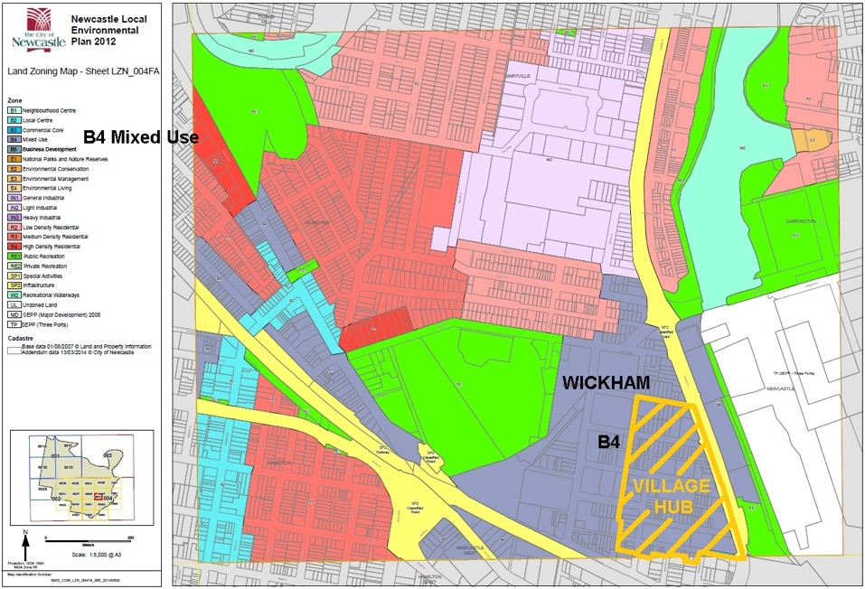
CURRENT LEP
“Zone B4 Mixed Use
. . .
4 Prohibited
. . . Dual occupancies; Dwelling houses; . . . Secondary dwellings; Semi-detached dwellings; . . .”
Village Hub in WMP:
Currently proposes “terrace style housing, shop top housing & smaller residential apartment buildings up to three storeys in height”
Because all of Wickham is zoned B4, this prohibits any single dwellings – but some of the remaining lots within the Village Hub are best suited to single dwellings, and this would also help achieve the aims of the WMP in terms of urban mix and community feel
Notes:
The current LEP shows most of Wickham as zoned B4 for Mixed Use. We are focused on the Village Hub.

Slide 3
VILLAGE HUB
Envisaged Village Hub viewed from the south (from WMP).
The envisaged Village Hub shows plenty of single dwellings.
Notes:
The Village Hub is all zoned B4. This character of this area . . . .

Slide 4
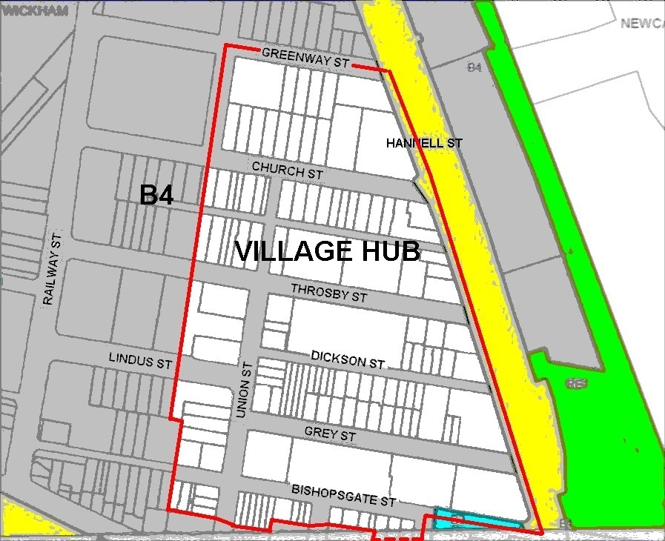
VILLAGE HUB
Development so far in the Village Hub:
Has left some ‘knock down’ properties on small lots – black mould, asbestos, ground level with no flood allowance
High land value & small size of these lots (& mine subsidence in some cases) make them unlikely for re-development under B4
Concerns the renewal in this part of Wickham is stalling, with these unable to be re-built as single dwellings and inappropriate for much else
Notes:
The Village Hub is all zoned B4. This character of this area . . . .

Slide 5
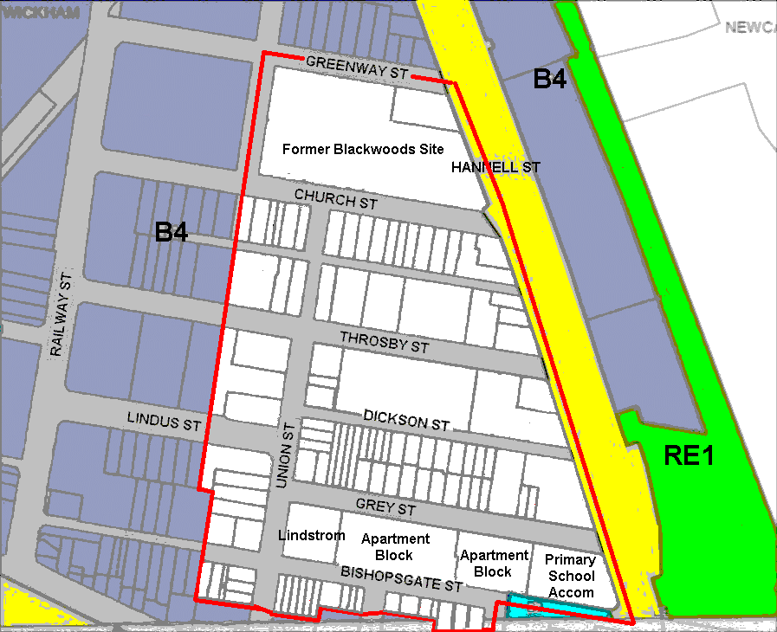
PROPOSED CHANGES TO ALLOW SINGLE DWELLINGS
The following changes are proposed within the Village Hub.
Notes:
The current LEP shows most of Wickham as zoned B4 for Mixed Use.

Slide 6
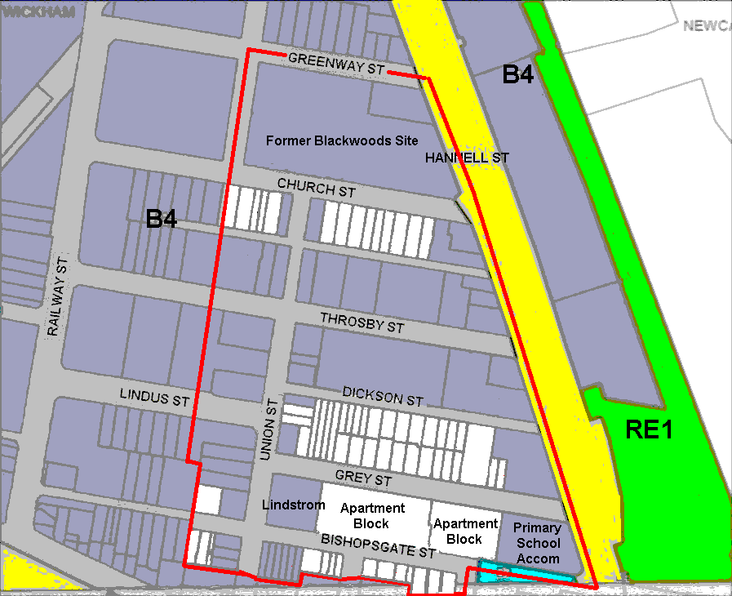
PROPOSED CHANGES
Properties on main thoroughfares stay B4.
  - Hannell St,
  - Throsby St, &
  - Union St
Exceptions – see later slide
Treat 6 terraces as a single property.
Notes:
The current LEP shows most of Wickham as zoned B4 for Mixed Use.

Slide 7
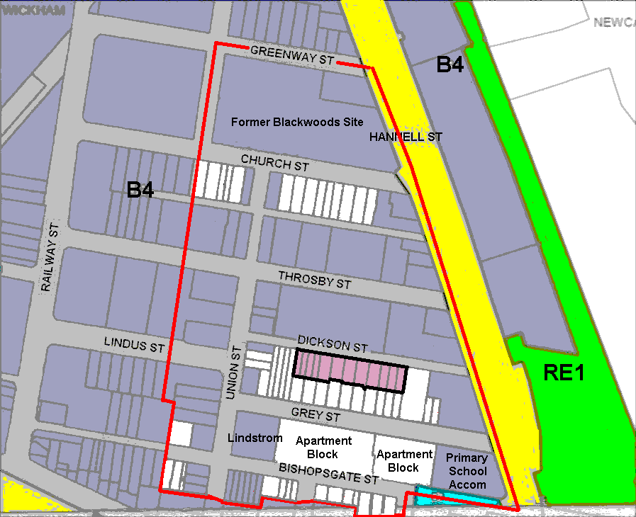
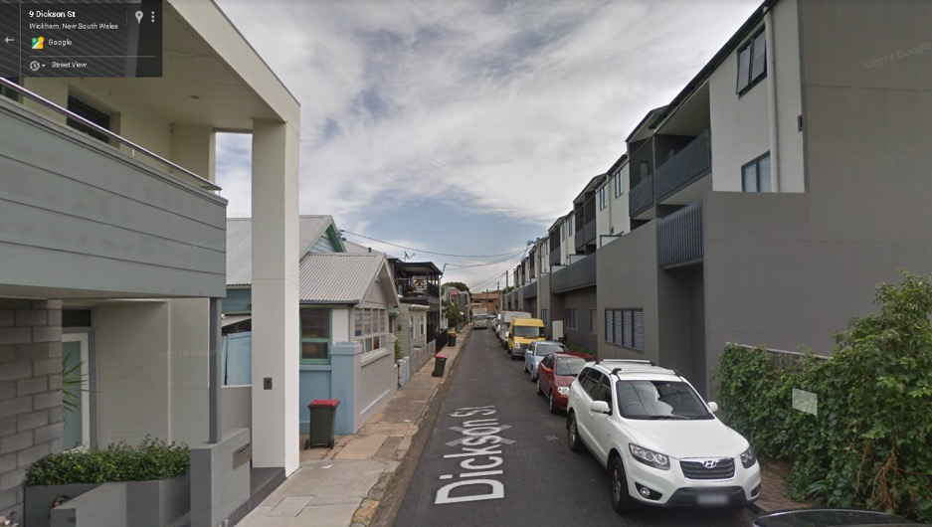
PROPOSED CHANGES
Properties on main thoroughfares stay B4.
Dickson St rezoned R2.
  This street only has houses and terraces at present.
  It is too narrow to support mixed uses.
R2
Notes:
The current LEP shows most of Wickham as zoned B4 for Mixed Use.

Slide 8
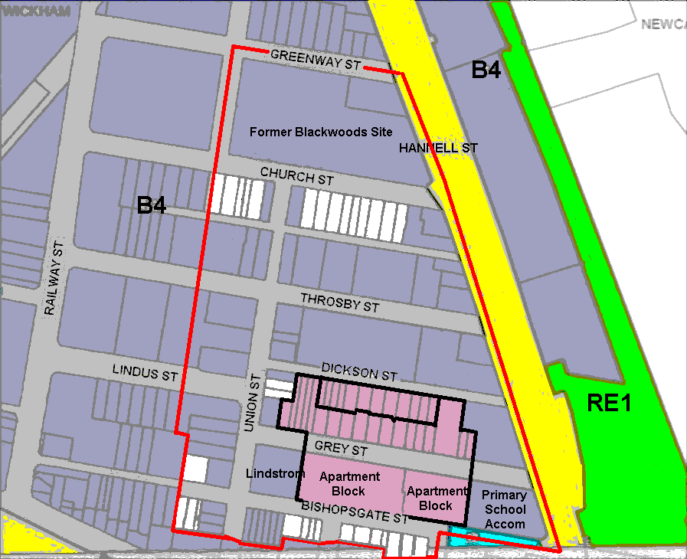
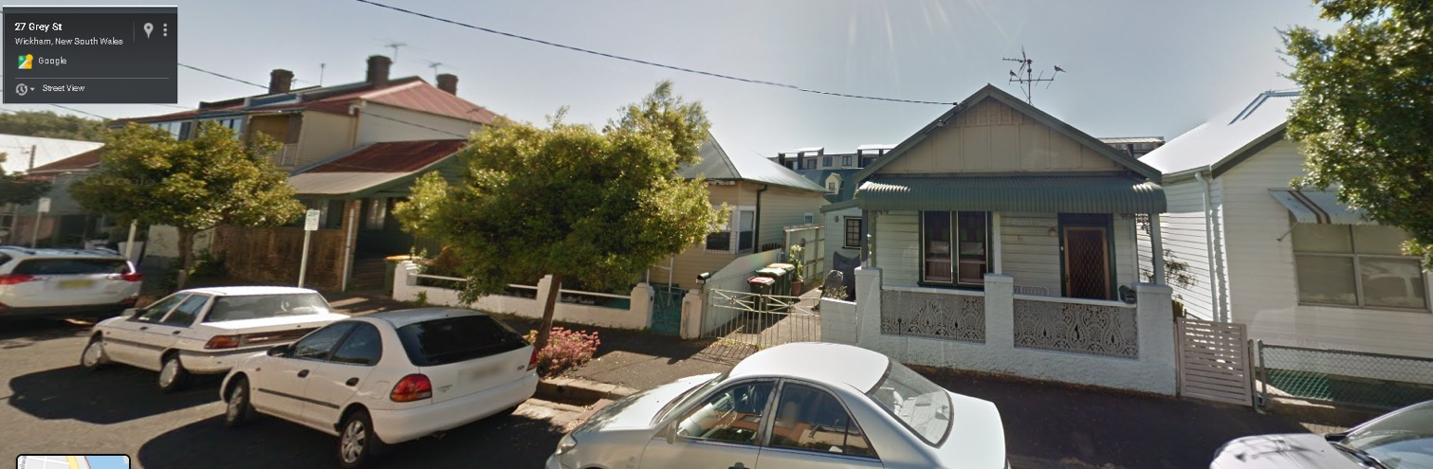
PROPOSED CHANGES
Properties on main thoroughfares stay B4.
Dickson St rezoned R2.
Grey St rezoned R2.
  This street only has houses, units and terraces at present, with one child care facility.
  Suggest maintaining this area of the Village Hub for long term residents, and permit major renovations to existing stock or knock-down rebuilds to zoning R2.
Existing child care centre run by Awabakal consistent with R2 zoning.
R2
R2
Notes:
The current LEP shows most of Wickham as zoned B4 for Mixed Use.

Slide 9
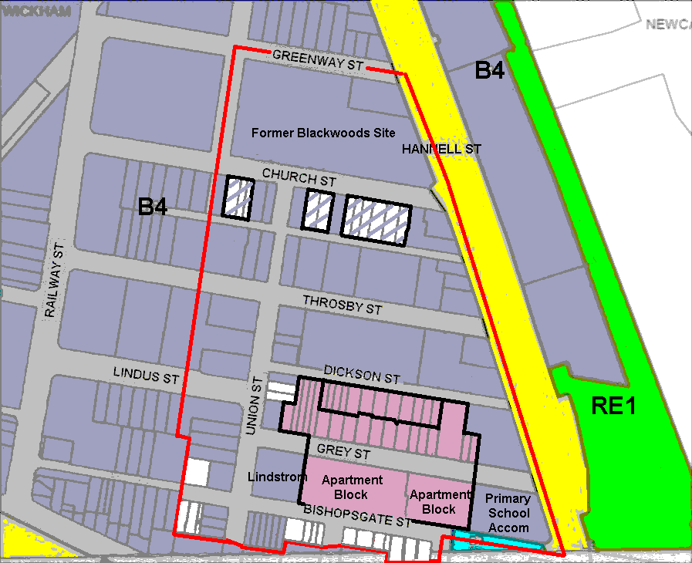
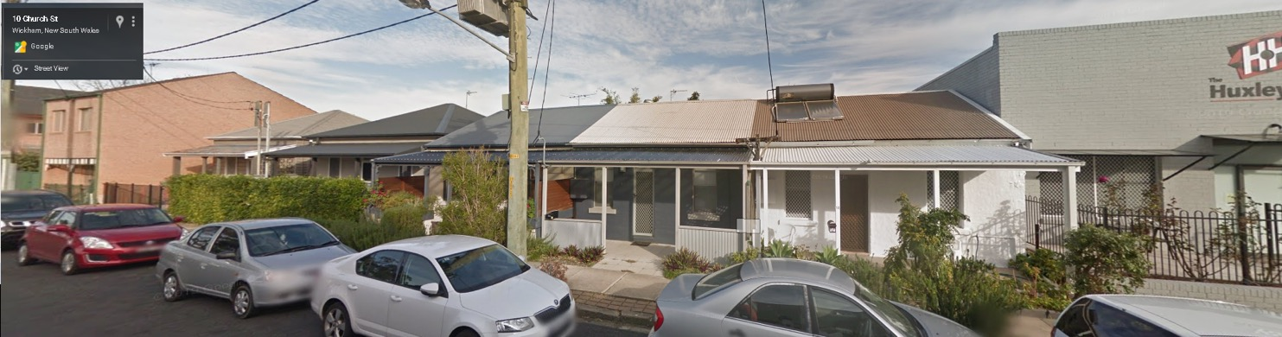
PROPOSED CHANGES
Existing businesses.
Properties on main thoroughfares stay B4.
Dickson St rezoned R2.
Grey St rezoned R2.
Church St permit houses and terraces B4+R2.
  Allow old housing stock to have major renovation or be rebuilt as single dwelling, units or terraces.
  Maybe rezone all R2, including the 3 businesses to establish Village Hub feel.
B4+R2
R2
R2
Notes:
The current LEP shows most of Wickham as zoned B4 for Mixed Use.

Slide 10
PROPOSED CHANGES
Mine Subsidence District.
This may limit major developments until grouting works are undertaken, so encouraging small lot development will fill the medium term development gap.
Properties on main thoroughfares stay B4.
Dickson St rezoned R2.
Grey St rezoned R2.
Church St permit houses and terraces B4+R2.
  Allow old housing stock to have major renovation or be rebuilt as single dwelling, units or terraces.
B4+R2
R2
R2
Notes:
The current LEP shows most of Wickham as zoned B4 for Mixed Use.

Slide 11
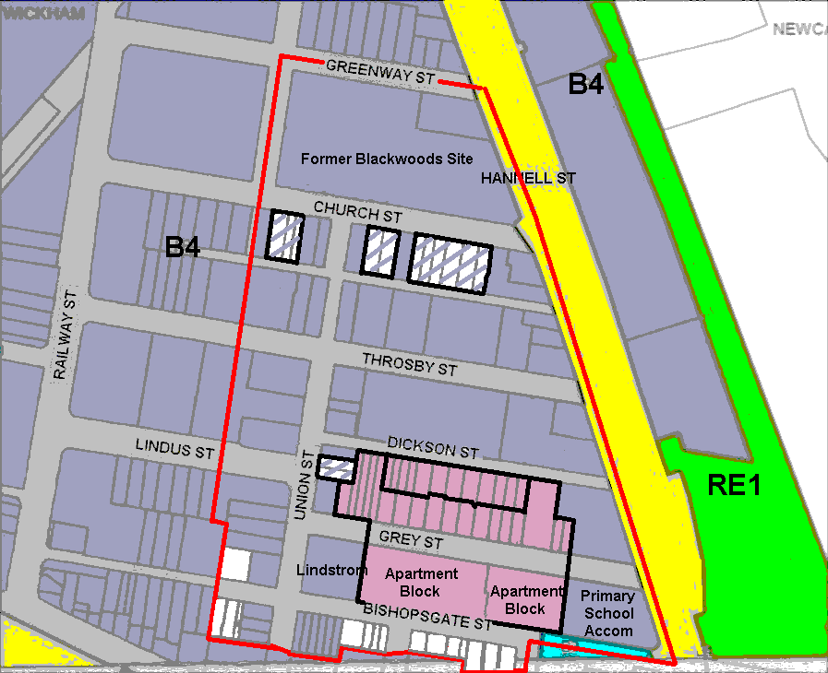
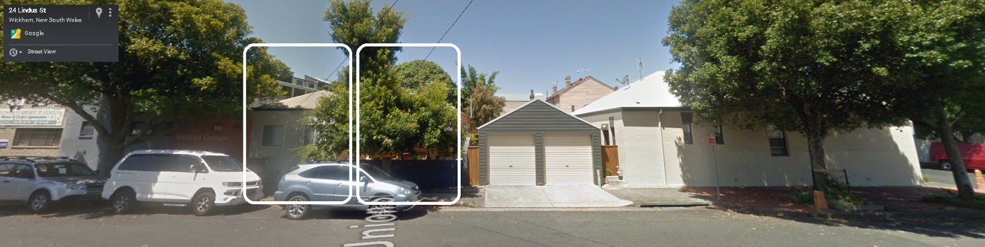
PROPOSED CHANGES
Frontage 6.6 m
Area 152 m²
Properties on main thoroughfares stay B4.
Dickson St rezoned R2.
Grey St rezoned R2.
Church St permit houses and terraces B4+R2.
Union St isolated blocks B4+R2.
  These two 150m² blocks are isolated between 2 very expensive homes. A B4 development is not very feasible, so suggest permitting R2 housing.
B4+R2
Two isolated small blocks – HOB 10m & FSR 1.5.
B4+R2
R2
R2
Notes:
The current LEP shows most of Wickham as zoned B4 for Mixed Use.

Slide 12
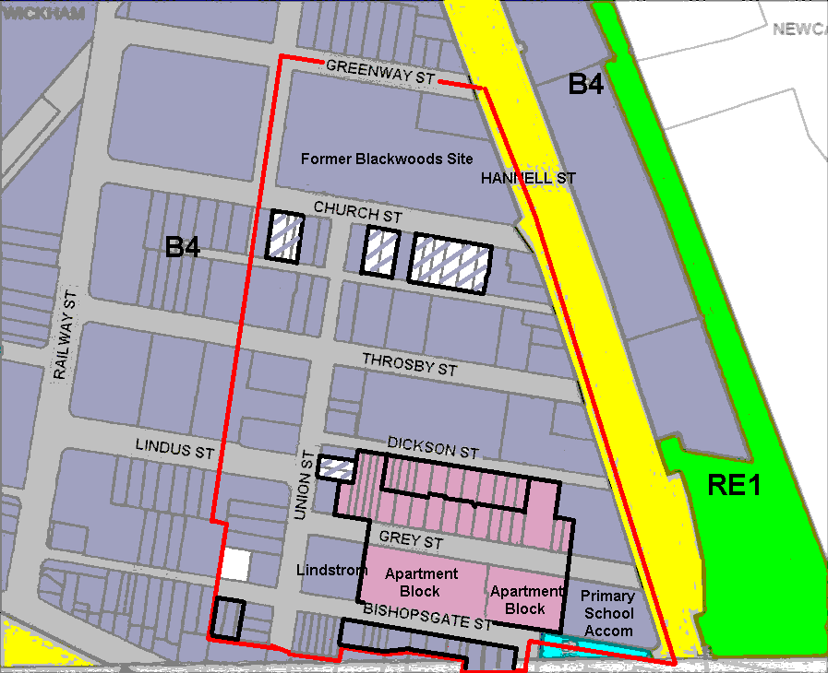
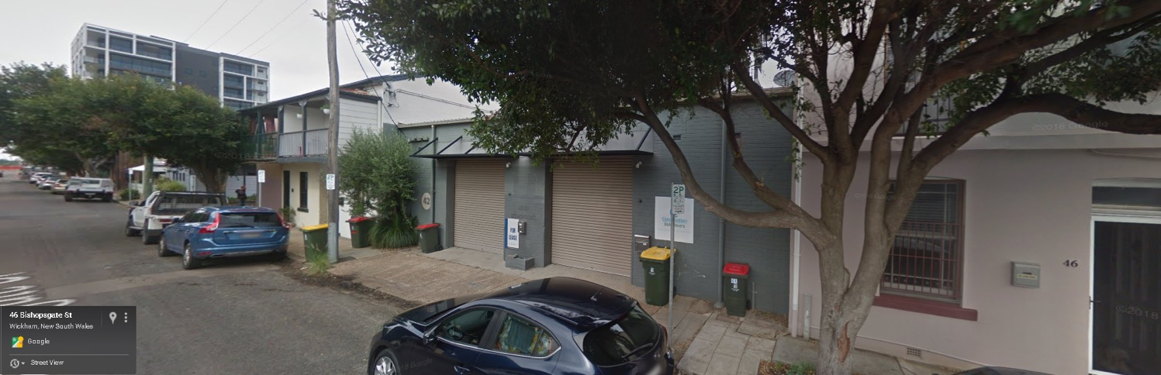
PROPOSED CHANGES
Properties on main thoroughfares stay B4.
Dickson St rezoned R2.
Grey St rezoned R2.
Church St permit houses and terraces B4+R2.
Union St isolated blocks B4+R2.
Bishopsgate St South leave as B4.
  If a house is built here it would block the planned density with HOB 24m and FSR 4.0.
  Leave as B4.
B4+R2
HOB 24 m
FSR 4.0
B4+R2
R2
R2
Notes:
The current LEP shows most of Wickham as zoned B4 for Mixed Use.

Slide 13
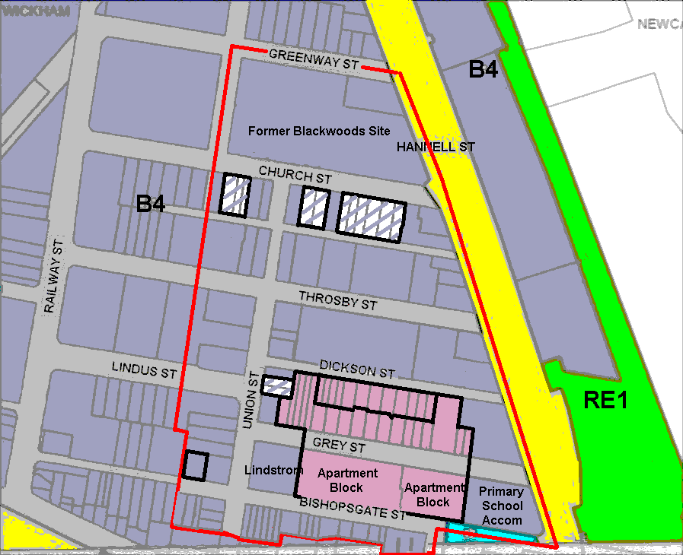
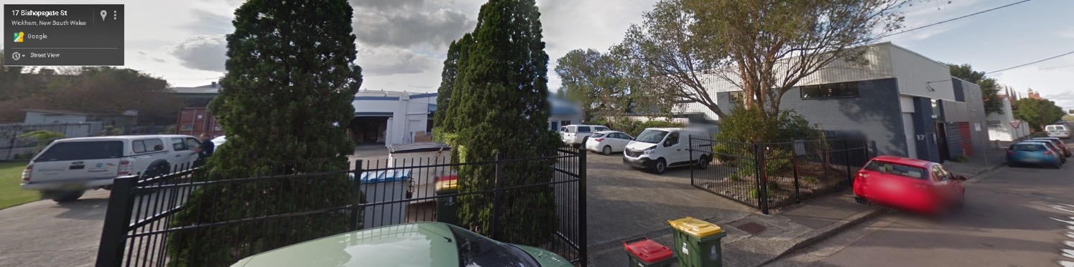
PROPOSED CHANGES
Properties on main thoroughfares stay B4.
Dickson St rezoned R2.
Grey St rezoned R2.
Church St permit houses and terraces B4+R2.
Union St isolated blocks B4+R2.
Bishopsgate St South leave as B4.
Bishopsgate St North leave as B4.
  Leave as B4.
B4+R2
Existing offices with workshop.
HOB 10 m & FSR 1.5.
B4+R2
R2
R2
Notes:
The current LEP shows most of Wickham as zoned B4 for Mixed Use.

Slide 14
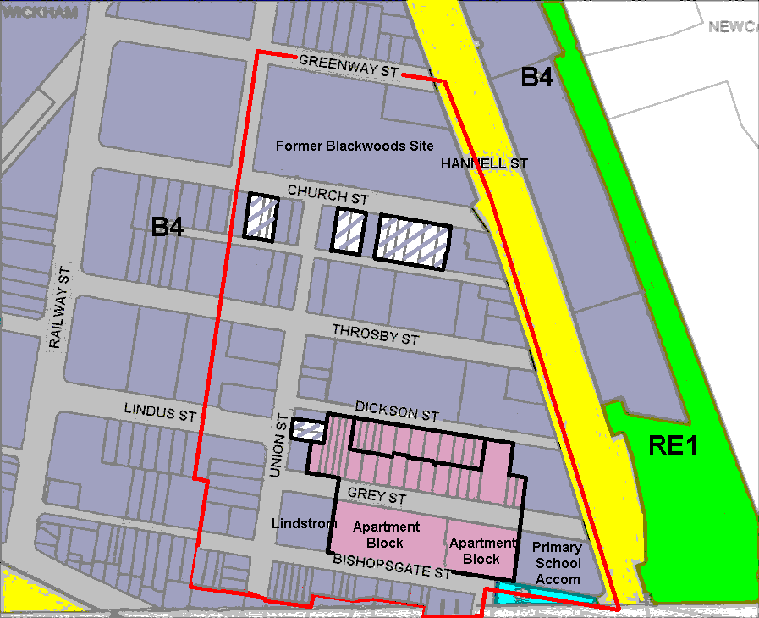
PROPOSED CHANGES
IN SUMMARY
Dickson St rezoned R2.
Grey St rezoned R2.
Church St permit houses and terraces B4+R2. Or maybe rezone all R2.
Union St isolated blocks B4+R2.
B4+R2
B4+R2
R2
R2
Notes:
The current LEP shows most of Wickham as zoned B4 for Mixed Use.

Slide 15
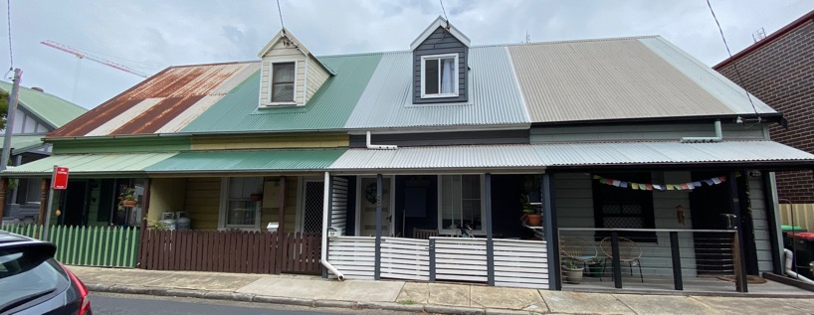
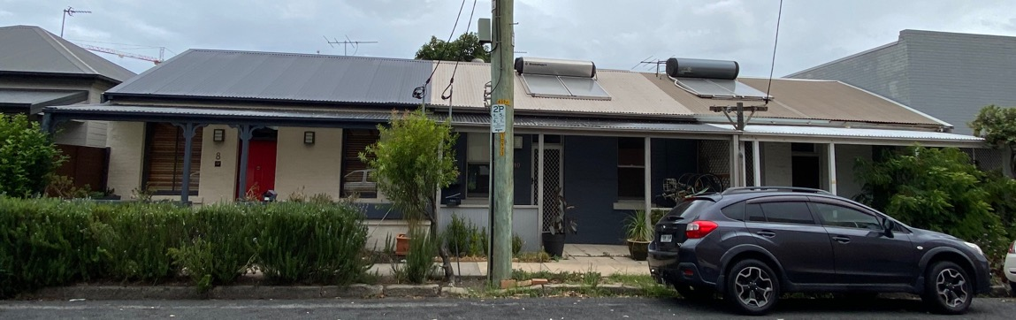
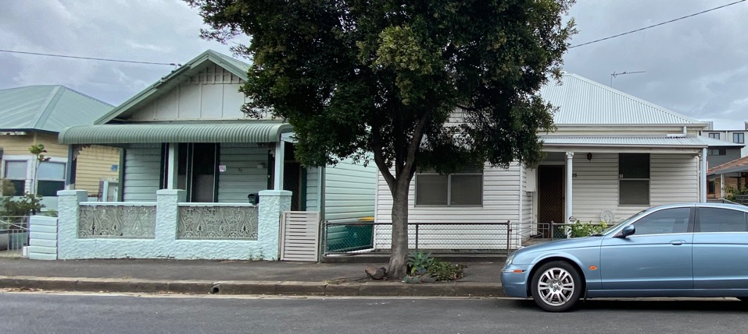
PROPOSED SINGLE DWELLING PERMITTED
`
Houses among the High Rises
Houses among the High Rises:
Allow small lots like these to rebuild single dwellings in Wickham’s “Village Hub”, to attract more permanent residents to the suburb, e.g. young families looking for a home close to the city centre
Add to community feel
Help achieve the right demographic & architectural mix for the Village Hub.
Ensure re-development doesn’t stall, and we aren’t left with isolated, sub-standard properties
Notes:
The Village Hub is all zoned B4. This character of this area . . . .

Slide 16
MECHANISMS
We are unsure how. Perhaps . . .
Via LEP
  Rezone R2, or
  Create an “Additional Permitted Uses Map”.
Via DCP 6.03, Wickham, to allow Section 4.6 variations for single dwellings.
Note: The small lot sizes with 10 m HOB means the 1.5 FSR are still achievable. That is, the required built form is still achieved.

Slide 17
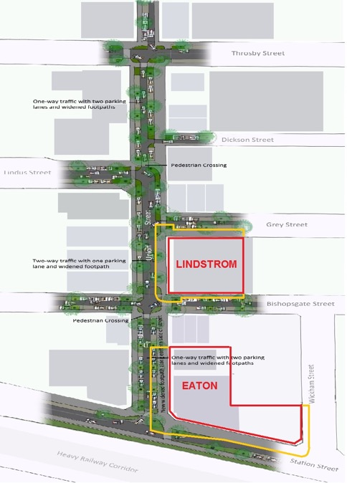
CONCLUSION
  Union St Upgrade
    Stage 1 – This year, construct east-side from Eaton to Bishopsgate St.
    Stage 2 – Revise S94A Contributions Plan to include eastern side from Grey St to Throsby St.
  Village Hub Permit Single Dwellings
    Permit single dwellings (R2 or some other mechanism) on certain remaining small lots in the Village Hub.

Slide 18
SUPPORTING INFORMATION
Notes:
The current LEP shows most of Wickham as zoned B4 for Mixed Use.

Slide 19
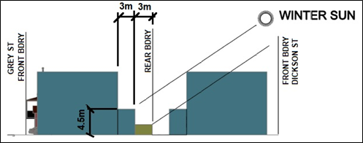
SINGLE DWELLING & FSR
  Using these rear setbacks to establish the building envelope. . .
  For owner occupiers, floorspace ratios of between 1.0 and 1.25 are easily achievable. For example, FSR 1.11 if:
  0.9m setback down one side,
  50% of the lower floor given to parking/services,
  60% of first floor area as habitable spaces (very generous front/rear balconies), and
  75% of second floor area as habitable spaces (mainly bedrooms on this level).
  To achieve a 1.5 FSR on a typical 10m wide lot with 0.9m side setbacks will require 92% of the available floor area on each level to be habitable spaces.
  To achieve a 1.5 FSR on a typical 10m wide lot with 0.0m side setbacks will require 77% of the available floor area on each level to be habitable spaces.
  This is in keeping with the bulking and massing characteristics required for the Village Hub and with building height/floor space ratio requirements.
Notes:
This information was presented by GLOW in its public submission on the latest revision of DCP 6.03, Wickham.

Slide 20
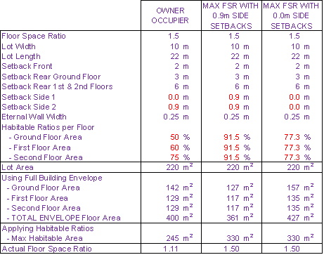
SINGLE DWELLING & FSR
  Supporting calculations.
Notes:
The current LEP shows most of Wickham as zoned B4 for Mixed Use.

Slide 21
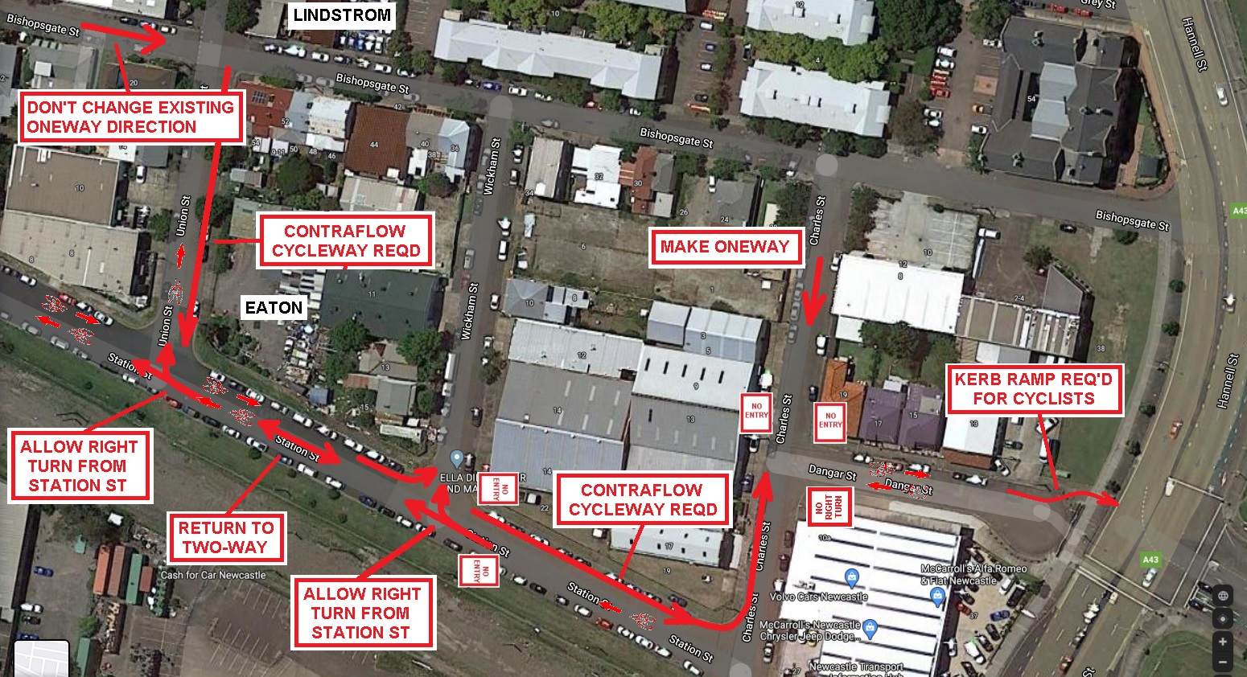
WICKHAM LATM STUDY – RECOMMENDED CHANGES
Notes:
The current LEP shows most of Wickham as zoned B4 for Mixed Use.

Slide 22
WICKHAM LATM STUDY – RECOMMENDED CHANGES
Most of these items were addressed with CoN traffic planner. During a during a site inspection. With regards the right turn from Railway to Union, see point 6 of the site visit minutes on the next slide.
Notes:
The current LEP shows most of Wickham as zoned B4 for Mixed Use.

Slide 23
WICKHAM LATM STUDY – RECOMMENDED CHANGES
Notes:
The current LEP shows most of Wickham as zoned B4 for Mixed Use.

Slide 24
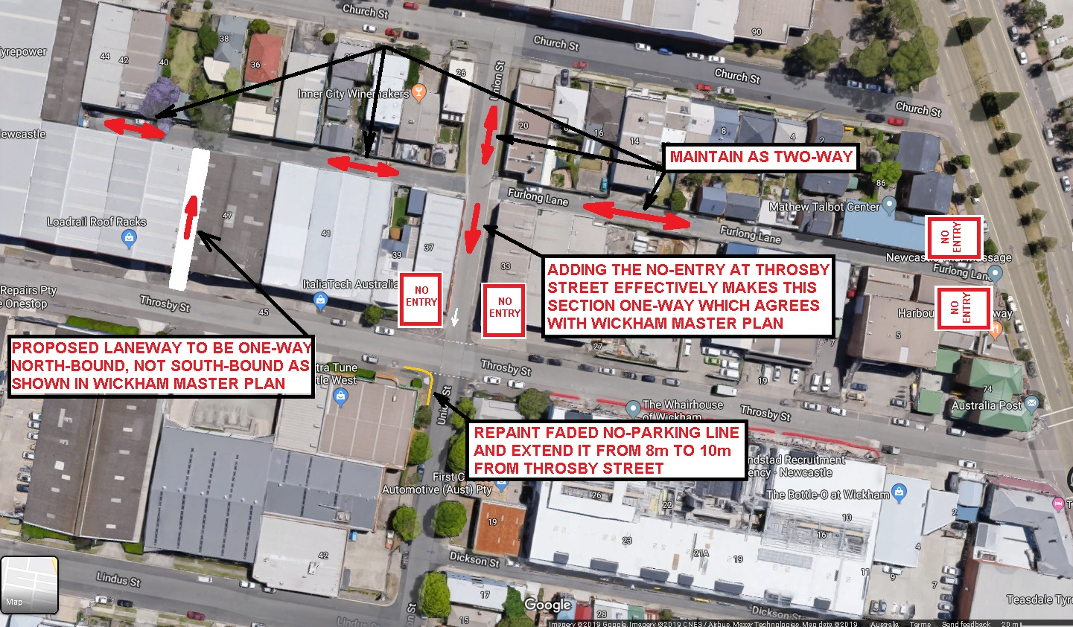
WICKHAM LATM STUDY – RECOMMENDED CHANGES
Notes:
The current LEP shows most of Wickham as zoned B4 for Mixed Use.

